Slide 1
EE-2003 Computer Organization & Assembly Language
INSTRUCTOR
Engr. Aashir Mahboob
Lecturer, Department of Computer Science
Office: Room No: 16, Opposite HoD (CS) Office
FAST NUCES (Karachi)
Aashir.mahboob@nu.edu.pk

Slide 2
CHAPTER No: 8
ADVANCE PROCEDURES

Slide 3
OUTLINE
Stack frames
Parameters
local variable

Slide 4
WHAT IS STACK FRAME?
The idea behind a stack frame is that each subroutine can act independently of its location on the stack, and each subroutine can act as if it is the top of the stack. When a function is called, a new stack frame is created at the current esp location. A stack frame acts like a partition on the stack.

Slide 5
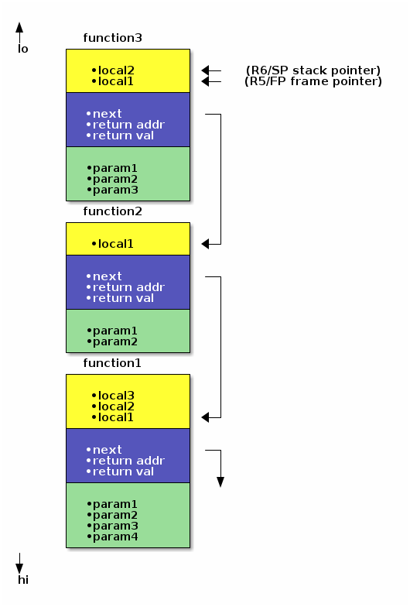
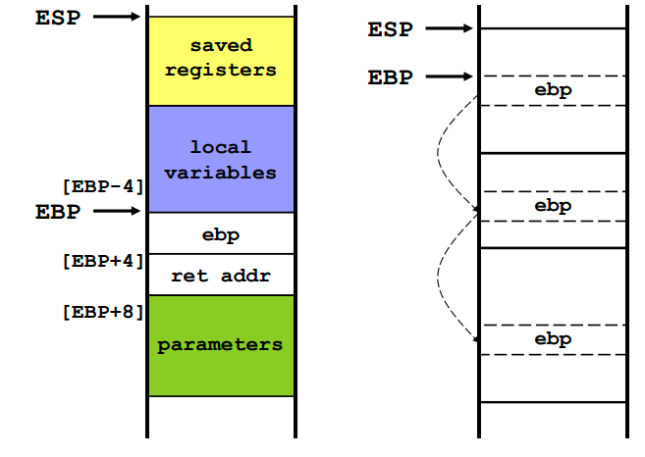

Slide 6
Parameter Passing
Parameter passing in assembly language is different
More complicated than that used in a high-level language
In assembly language
Place all required parameters in an accessible storage area
Then call the procedure
Two types of storage areas used
Registers: general-purpose registers are used (register method)
Memory: stack is used (stack method)
Two common mechanisms of parameter passing
Pass-by-value: parameter value is passed
Pass-by-reference: address of parameter is passed

Slide 7
Stack Parameters
Consider the following max procedure
int max ( int x, int y, int z ) {
int temp = x;
if (y > temp) temp = y;
if (z > temp) temp = z;
return temp;
}
Calling procedure: mx = max(num1, num2, num3)
Register Parameters
mov eax, num1
mov ebx, num2
mov ecx, num3
call max
mov mx, eax
Stack Parameters
push num3
push num2
push num1
call max
mov mx, eax
Reverse
Order

Slide 8
Parameters
Two types: register parameters and stack parameters.
Stack parameters are more convenient than register parameters.
Example demonstrates calling DumpMem using register parameters and stack parameters
; Register Parameters
pushad
mov esi, OFFSET array
mov ecx, LENGTHOF array
mov ebx, TYPE array
call DumpMem
popad
;Stack Parameters
push TYPE array
push LENGTHOF array
push OFFSET array
call DumpMem

Slide 9
Register versus Stack Parameters
Passing Parameters in Registers
Pros: Convenient, easier to use, and faster to access
Cons: Only few parameters can be passed
A small number of registers are available
Often these registers are used and need to be saved on the stack
Pushing register values on stack negates their advantage
Passing Parameters on the Stack
Pros: Many parameters can be passed
Large data structures and arrays can be passed
Cons: Accessing parameters is not simple
More overhead and slower access to parameters

Slide 10
Arguments pushed on the stack
Two general types of arguments are pushed on the stack during subroutine calls:
Value arguments (values of variables and constants)
Reference arguments (addresses of variables)

Slide 11
Passing by value:
When an argument is passed by value, a copy of the value is pushed on the stack.
Passing by Reference
An argument passed by reference consists of the address (offset) of an object.
Passing Arrays
High-level languages always pass arrays to subroutines by reference. That is, they push the address of an array on the stack. one would not want to pass an array by value, because doing so would require each array element to be pushed on the stack separately. Such an operation would be very slow, and it would use up precious stack space.

Slide 12
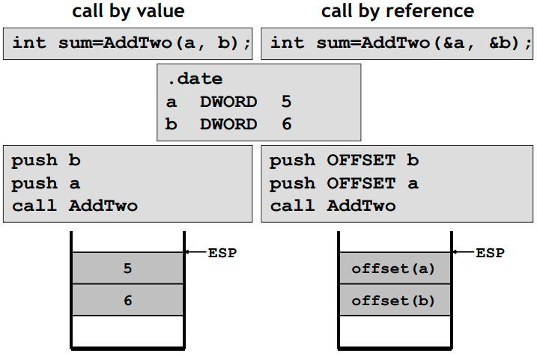
Passing by value and passing by reference
a

Slide 13
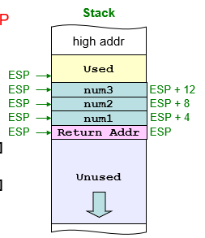
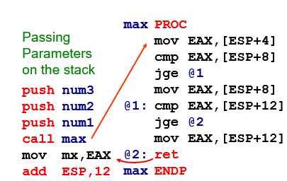
Passing Parameters on the Stack
Calling procedure pushes parameters on the stack
Procedure max receives parameters on the stack
Parameters are pushed in reverse order
Parameters are located relative to ESP

Slide 14
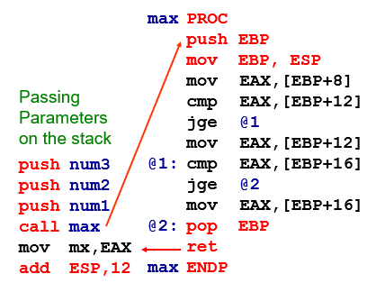
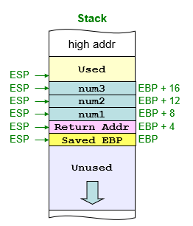
Using the Base Pointer Register
EBP is used to locate parameters on the stack
Like any other register, EBP must be saved before use

Slide 15
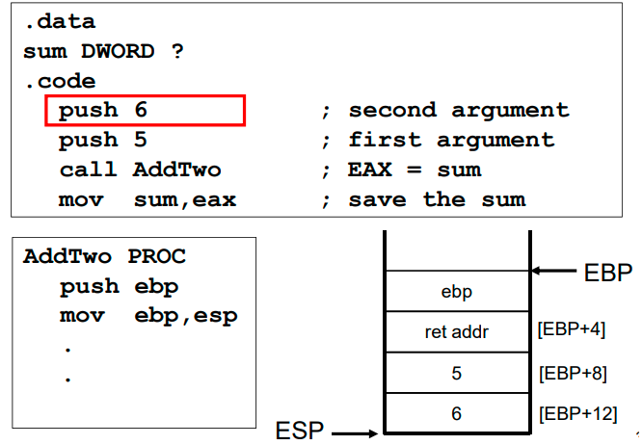
Stack Frame Example:
int AddTwo( int x, int y )
{ return x + y;
}

Slide 16
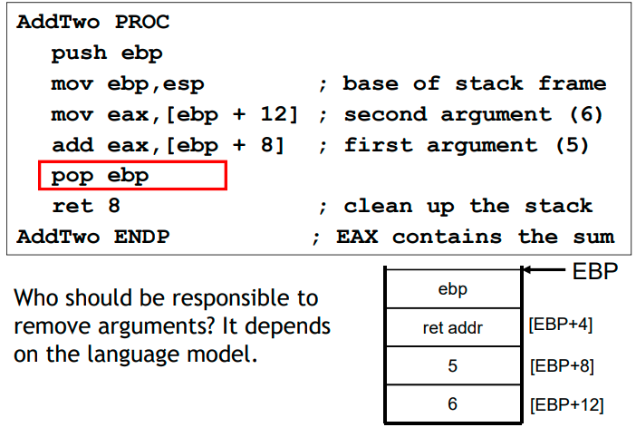
Stack Frame Example:

Slide 17
Base-Offset Addressing
We will use base-offset addressing to access stack parameters. EBP is the base register and the offset is a constant. 32-bit values are usually returned in EAX. The following implementation of AddTwo adds the parameters and returns their sum in EAX:
AddTwo PROC
push ebp
mov ebp,esp ; base of stack frame
mov eax,[ebp + 12] ; second parameter
add eax,[ebp + 8] ; first parameter
pop ebp
ret
AddTwo ENDP

Slide 18
Explicit Stack Parameters
When stack parameters are referenced with expressions such as [ebp+8] we call them explicit stack parameters . The reason for this term is that the assembly code explicitly states the offset of the parameter as a constant value.

Slide 19
Cleaning up the stack
There must be a way for parameters to be removed from the stack when a subroutine returns. Otherwise, a memory leak would result, and the stack would become corrupted.
Example:
main PROC
call Example1
exit
main ENDP
Example1 PROC
push 6
push 5
call AddTwo
ret ; stack is corrupted!
Example1 ENDP

Slide 20
Who Should Clean up the Stack?
When returning for a procedure call …
Who should remove parameters and clean up the stack?
Clean-up can be done by the calling procedure
add ESP,12 ; will clean up stack
Clean-up can be done also by the called procedure
We can specify an optional integer in the ret instruction
ret 12 ; will return and clean up stack
Return instruction is used to clean up stack
ret n ; n is an integer constant
Actions taken
EIP = [ESP]
ESP = ESP + 4 + n

Slide 21
Ret Instruction
Return from subroutine
Pops stack into the instruction pointer (EIP or IP). Control transfers to the target address.
Syntax:
RET
RET n
Optional operand n causes n bytes to be added to the stack pointer after EIP (or IP) is assigned a value.

Slide 22
Local Variables
The variables defined in the data segment can be taken as static, global variables
Visibility
Static 🡪 program duration
Global 🡪 the whole program
A local variable is created, used, and destroyed within a single procedure (block)
Advantages of local variables:
Restricted access: easy to debug, less error prone
Efficient memory usage
Same names can be used in two different procedures
Essential for recursion

Slide 23
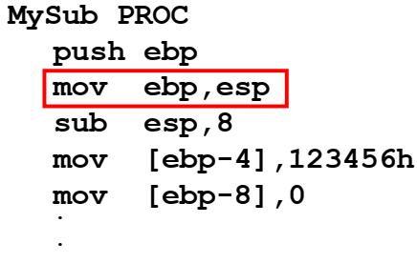
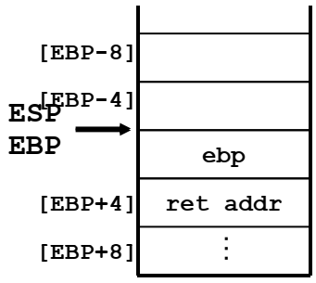
Creating Local Variable
Local variables are created on the runtime stack, usually above EBP
To explicitly create local variables, subtract their total size from ESP

Slide 24
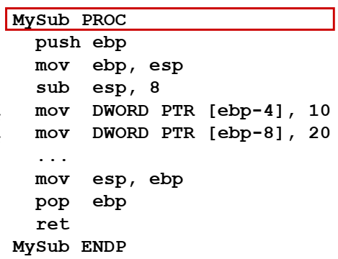
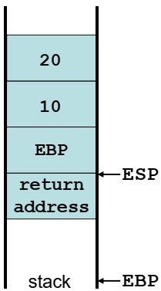
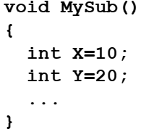
Local Variable
They can’t be initialized at assembly time but can be assigned to default values at runtime

Slide 25
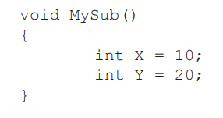
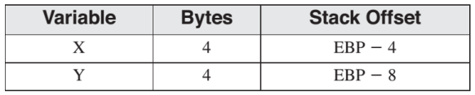
LOCAL VARIABLES
•Local variables are created on the runtime stack, usually below the base pointer (EBP).

Slide 26
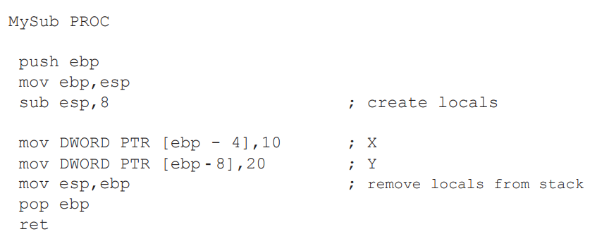
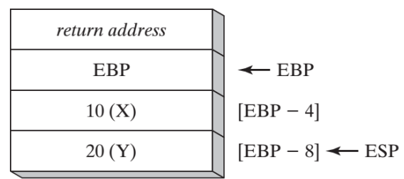
LOCAL VARIABLES

Slide 27
ENTER AND LEAVE INSTRUCTIONS
•The ENTER instruction performs three operations:
Pushes EBP on the stack (push ebp)
Sets EBP to the base of the stack frame (mov ebp, esp)
3. Reserves space for local variables (sub esp,numbytes)
ENTER numbytes, nestinglevel
•Both the operands are immediate values,
•The first is a constant specifying the number of bytes of stack space to reserve for local variables.
•The second specifies the lexical nesting level of the procedure.

Slide 28


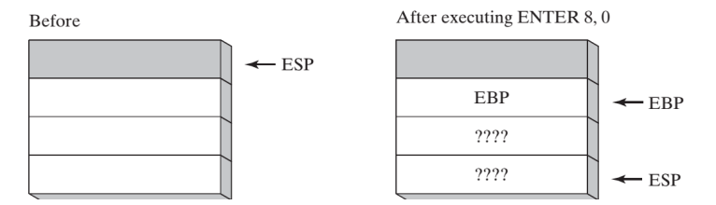
ENTER AND LEAVE INSTRUCTIONS
E.g. a procedure with no local variables:
E.g. The ENTER instruction reserves 8 bytes of stack space for local variables.

Slide 29
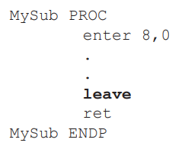

ENTER AND LEAVE INSTRUCTIONS
•The LEAVE instruction terminates the stack frame for a procedure.
• It reverses the action of a previous ENTER instruction by restoring ESP and EBP to the values they were assigned when the procedure was called.

Slide 30


LOCAL DIRECTIVE
LOCAL declares one or more local variables by name, assigning them size attributes.
ENTER, on the other hand, only reserves a single unnamed block of stack space for local variables.
If used, LOCAL must appear on the line immediately following the PROC directive.

Slide 31
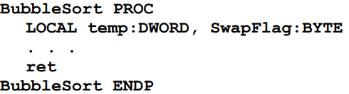
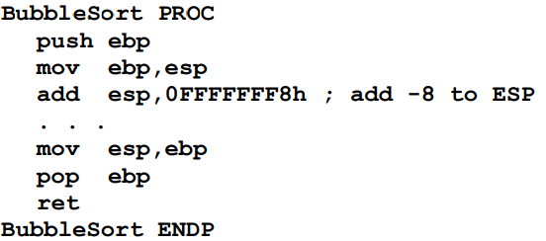
LOCAL DIRECTIVE (EXAMPLE)

Slide 32
Non-Doubleword Local Variables
• Local variables can be different sizes.
• How are they created in the stack by LOCAL directive:
– 8-bit: assigned to next available byte
– 16-bit: assigned to next even (word) boundary
– 32-bit: assigned to next doubleword boundary

Slide 33
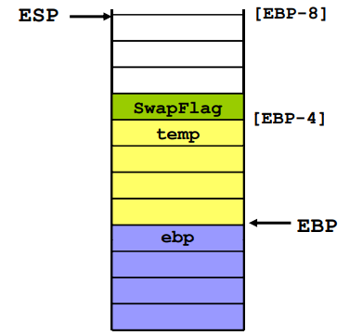

LOCAL DIRECTIVE (EXAMPLE)

Slide 34
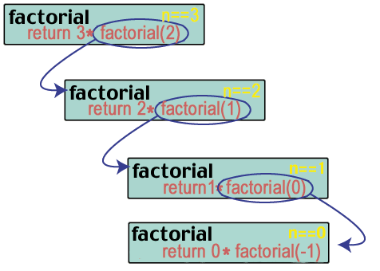
Recursion
The process in which a function calls itself directly or indirectly is called recursion and the corresponding function is called as recursive function.

Slide 35
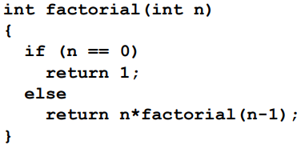
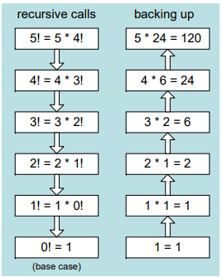
EXAMPLE (Factorial)
This function calculates the factorial of integer n. A new value of n is saved in each stack frame:

Slide 36
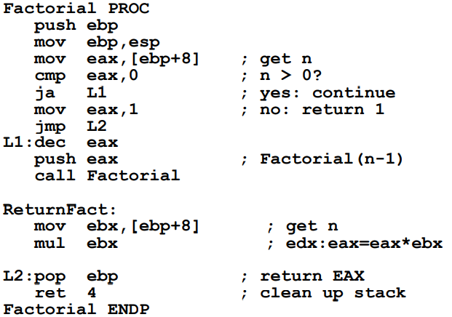
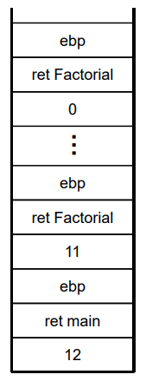
EXAMPLE (Factorial)

Slide 37
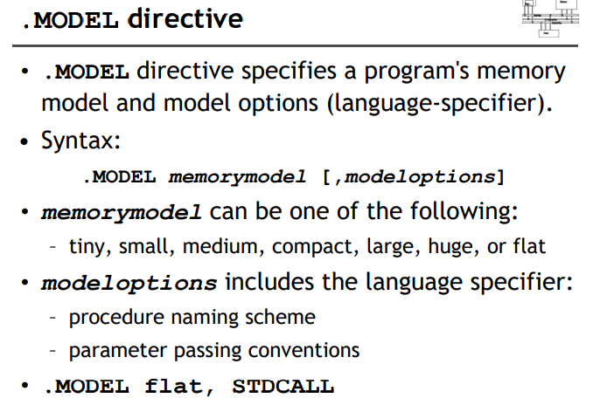
Related directives

Slide 38
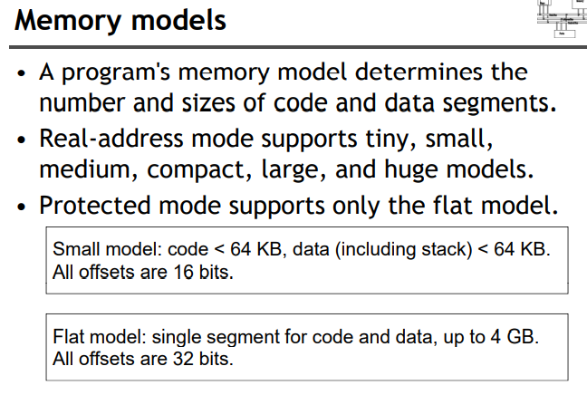

Slide 39
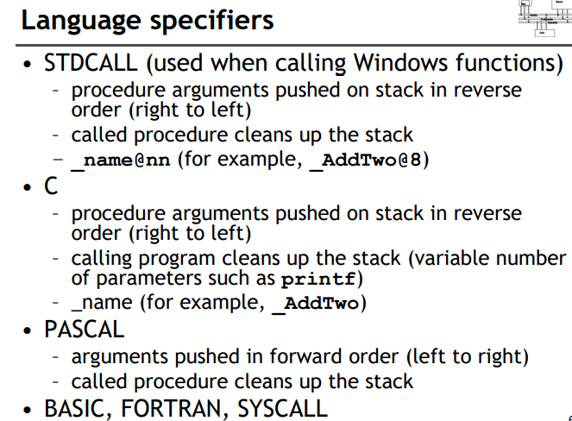

Slide 40
INVOKE DIRECTIVE
•The INVOKE directive, only available in 32-bit mode, pushes arguments on the stack and calls a procedure.
•INVOKE is a convenient replacement for the CALL instruction because it lets you pass multiple arguments using a single line of code.
INVOKE procedureName [, argumentList]

Slide 41
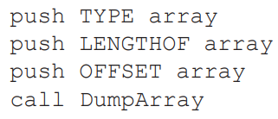
CALL VS INVOKE
The equivalent statement using INVOKE is reduced to a single line in which the arguments are listed in reverse order (assuming STDCALL is in effect).
INVOKE DumpArray, OFFSET array, LENGTHOF array, TYPE array

Slide 42
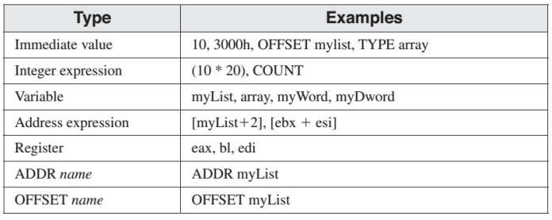
INVOKE permits almost any number of arguments, and individual arguments can appear on separate source code lines.

Slide 43
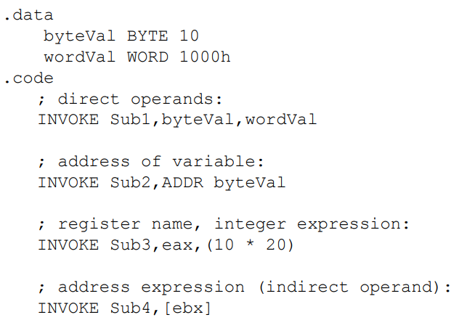
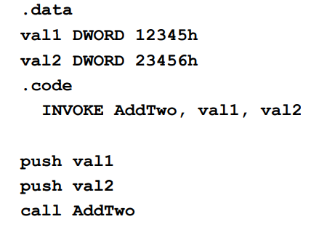
EXAMPLE

Slide 44
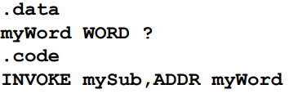
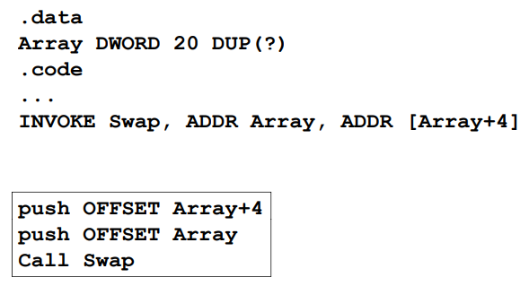
ADDR OPERATOR
•Returns a near or far pointer to a variable, depending on which memory model your program uses:
• Small model: returns 16-bit offset
• Large model: returns 32-bit segment/offset
• Flat model: returns 32-bi ff t o set
•The ADDR operator can only be used in conjunction with INVOKE:

Slide 45
PROC DIRECTIVE
The PROC directive declares a procedure with an optional list of named parameters.
label PROC, parameter_list
•The PROC directive permits you to declare a procedure with a comma-separated list of named parameters.
label PROC, parameter_1, parameter_2, ..., parameter_n
•Your implementation code can refer to the parameters by name rather than by calculated stack offsets such as [ebp - 8].

Slide 46
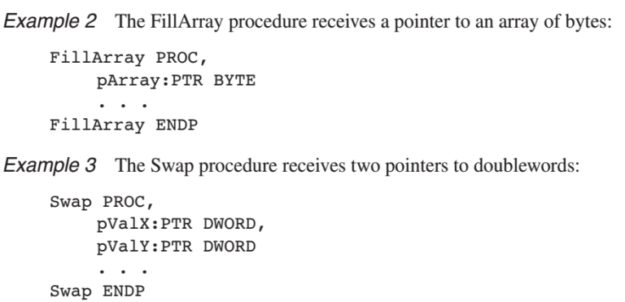
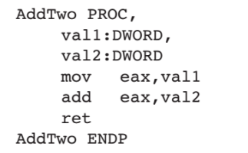
PROC example
The AddTwo procedure receives two integers and returns their sum in EAX.

Slide 47
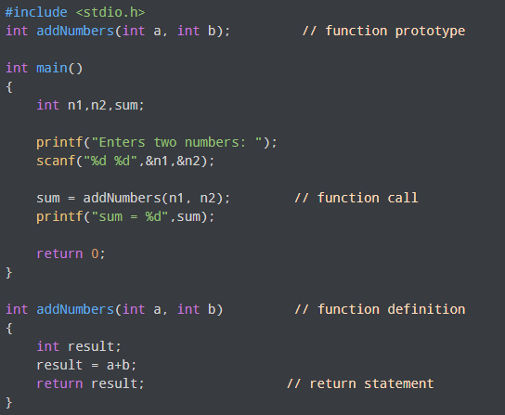
PROTO DIRECTIVE

Slide 48
PROTO DIRECTIVE
•Creates a procedure prototype
label PROTO paramList
•Every procedure called by the INVOKE directive must have a prototype.
•A complete procedure definition can also serve as its own prototype.
•Standard configuration: PROTO appears at top of the program listing, INVOKE appears in the code segment, and the procedure implementation occurs later in the program.

Slide 49
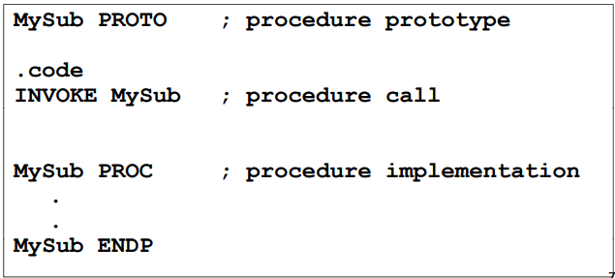
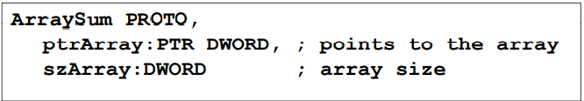
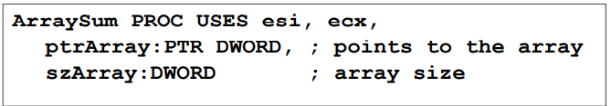
EXAMPLE
• Prototype for the ArraySum procedure, showing its parameter list:

Slide 50
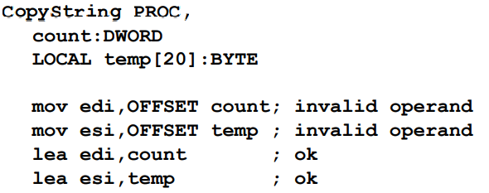
LEA instruction (load effective address)
• The LEA instruction returns offsets of both direct and indirect operands at run time.
– OFFSET only returns constant offsets (assemble time).
• LEA is required when obtaining the offset of a stack parameter or local variable. For example:

Slide 51
Recursion
The process in which a function calls itself directly or indirectly is called recursion and the corresponding function is called as recursive function.

Slide 52
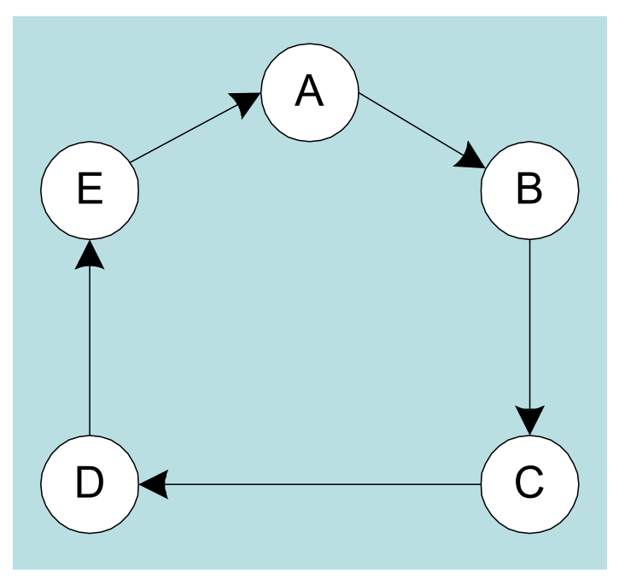
Recursion
The process created when . . .
A procedure calls itself
Procedure A calls procedure B, which in turn calls procedure A
Using a graph in which each node is a procedure and each edge is a procedure call, recursion forms a cycle

Slide 53
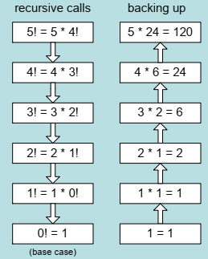
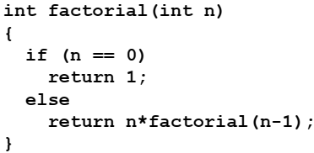

Recursion
This function calculates the factorial of integer n
A new value of n is saved in each stack frame

Slide 54

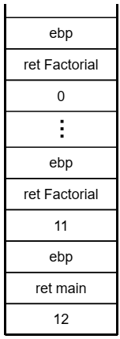
Recursion

Slide 55


